Slide 1



Work absenteeism bonus practice
View in Power BI
Last data refresh:
11/19/2023 5:29:46 PM UTC
Downloaded at:
11/19/2023 5:31:46 PM UTC

Slide 2
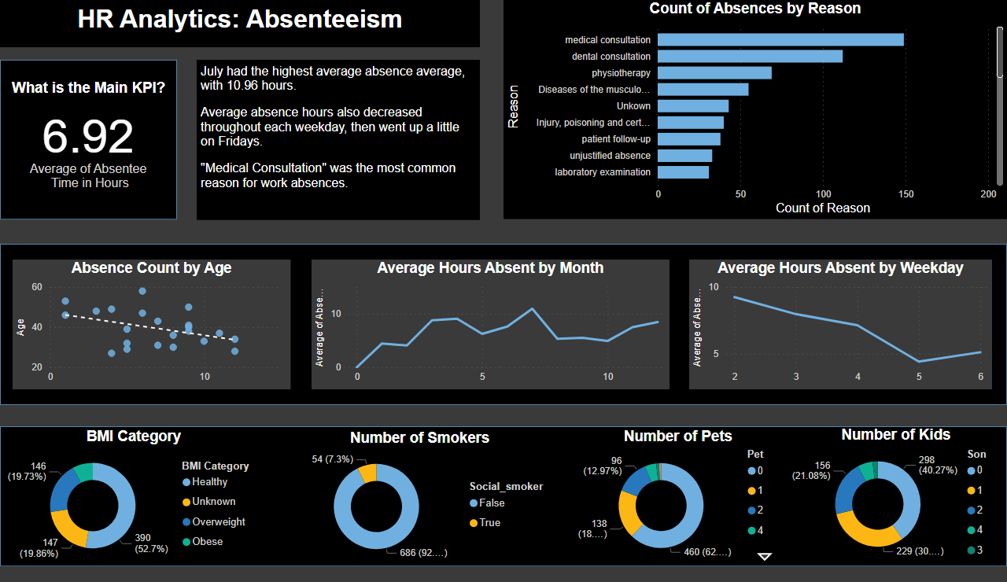
Page 1
Notes:
BMI Category
No alt text provided
Average Hours of Absentee Time
No alt text provided
Number of Smokers
No alt text provided
Number of Pets
No alt text provided
Number of Kids
No alt text provided
textbox
No alt text provided
textbox
No alt text provided
Average Hours Absent by Month
No alt text provided
Average Hours Absent by Weekday
No alt text provided
textbox
No alt text provided
Count of Absences by Reason
No alt text provided
scatterChart
No alt text provided
shape
No alt text provided
textbox
No alt text provided
shape
No alt text provided
textbox
No alt text provided
shape
No alt text provided
textbox
No alt text provided

